Slide 1
Berlin wall
By Anthony Watson

Slide 2
What is the berlin wall
The Berlin Wall was a wall that divided Berlin from 1961 to 1989, made by the German Democratic Republic (GDR, East Germany) starting on 13 August 1961, that completely cut off West Berlin from surrounding East Germany and from East Berlin until it was opened in November 1989. so that means east berlin had no contacted with the out side world. Inbetween the walls there was a zone call no mans land were if some went there who was not a solider there were shot

Slide 3
JFK speech
US President John F Kennedy visited West-Berlin He made a speech an said
Two thousand years ago, the proudest boast was civis romanus sum ["I am a Roman citizen"]. Today, in the world of freedom, the proudest boast is "Ich bin ein Berliner!"... All free men, wherever they may live, are citizens of Berlin, and therefore, as a free man, I take pride in the words "Ich bin ein Berliner!“
There is a misconception that Kennedy made a risible error by saying Ich bin ein Berliner the claim is made that Kennedy referred to himself not as a "citizen of Berlin" but as a "jelly doughnut"

Slide 4
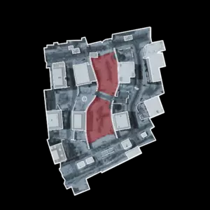
Call of duty
In call of duty black ops 1 there was a map with the berlin wall
Berlin Wall is a medium-sized urban snow set terrain map set in Germany with several large buildings and a "No-man's land" where automatic turrets will fire at anyone goes in that area The "No-man's land" is highlighted in red on the mini-map There is also a small path in the middle of "No-man's land" which leads to both sides of the map.. On one side of the map there is an ally checkpoint, with small security buildings, gates and tanks.

Slide 5
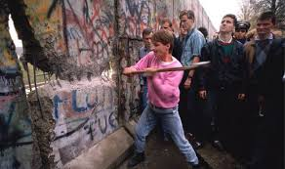
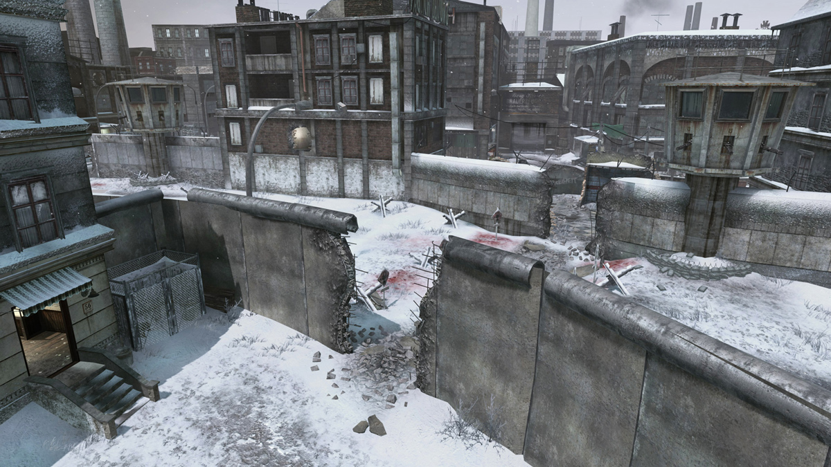
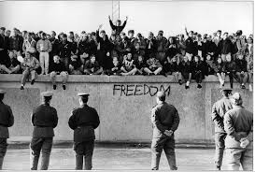
images

